Slide 1

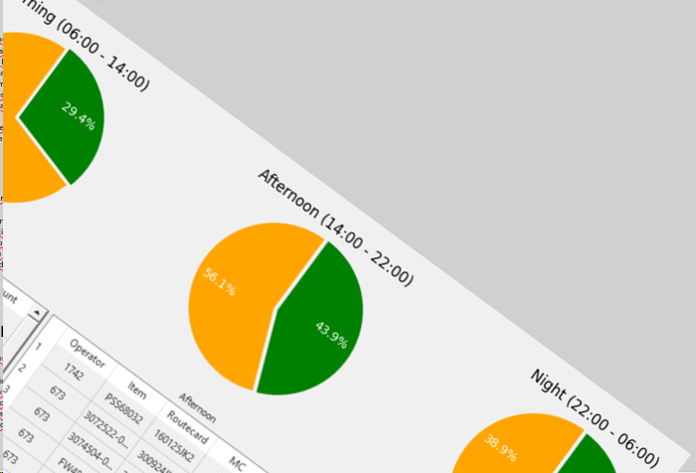
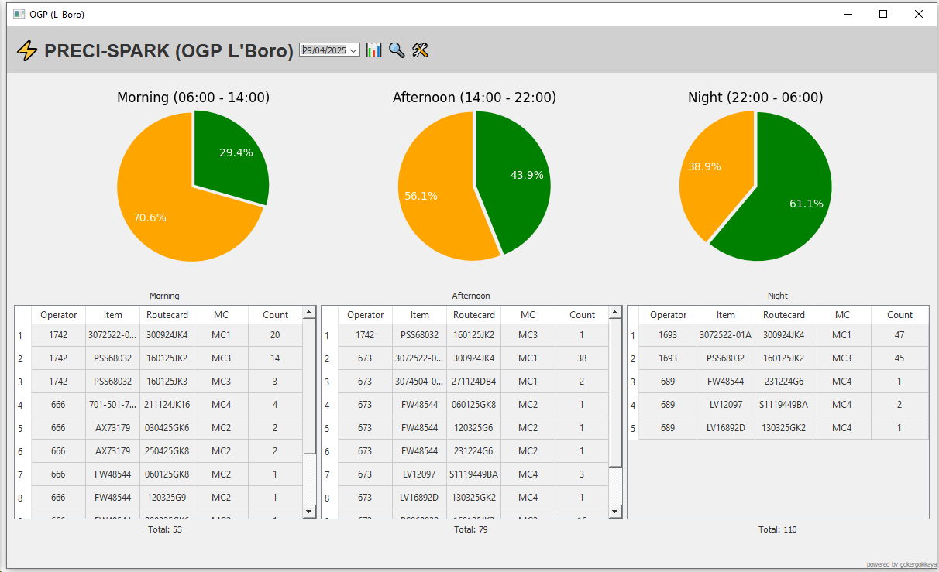

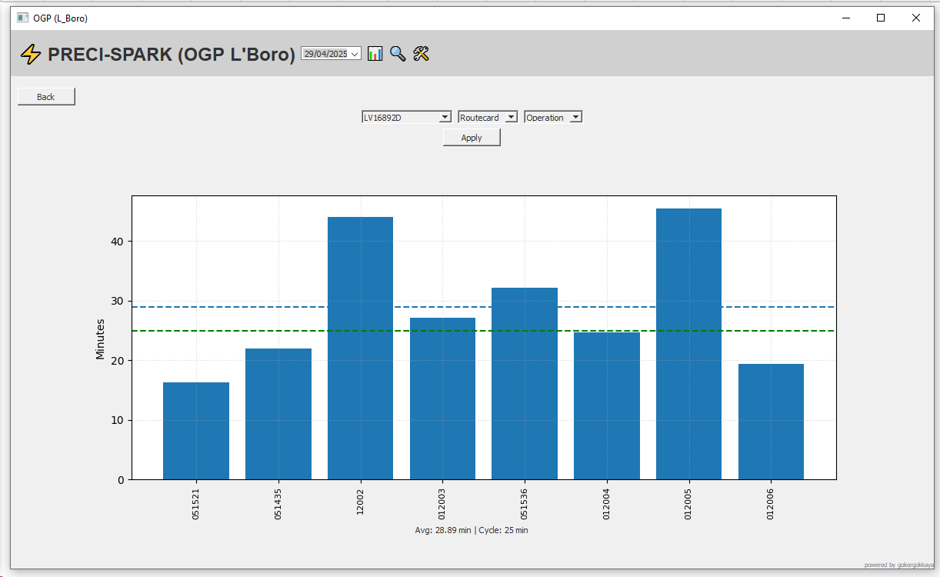
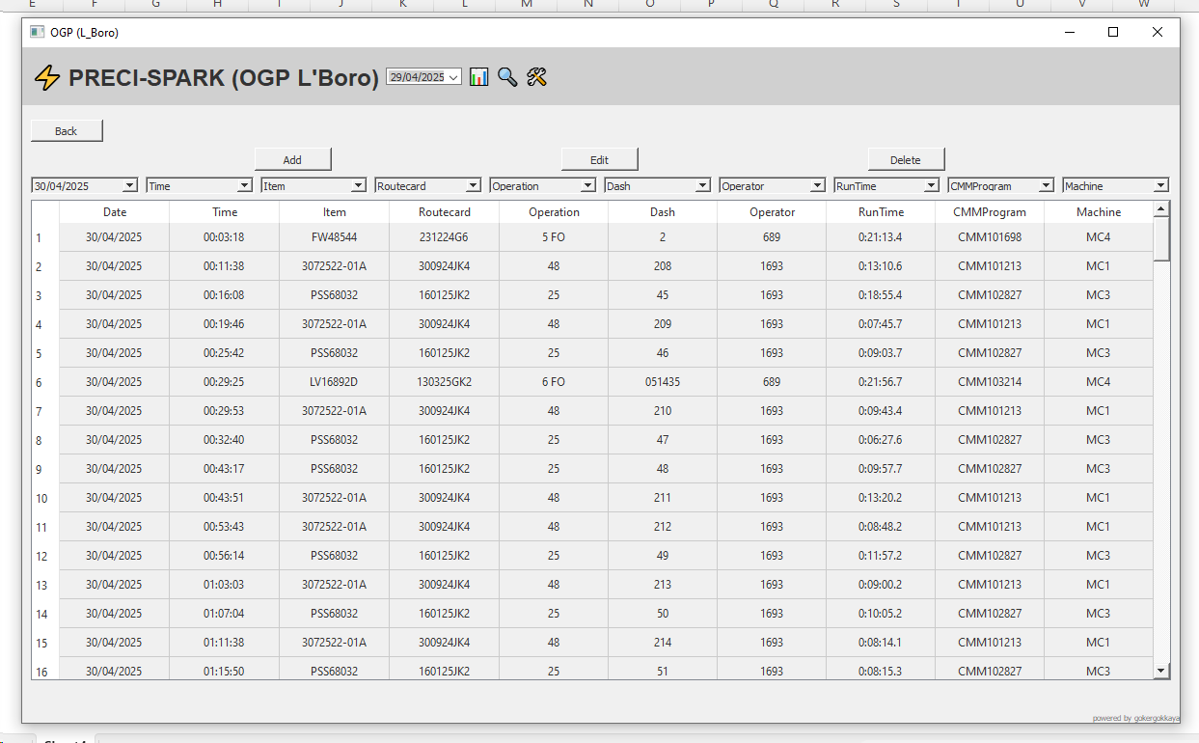
⚡ PRECI-SPARK
OGP (Coalville)
OGP (L’Boro)
Dashboard
This screen provides an overview of daily shift performance. Performance is calculated based on a 100% scale, assuming all four machines operate at full capacity throughout the day, with a standard allowance of one 30-minute stop. Even if a machine is idle due to lack of work, this is still reflected as a performance decrease, since the OGP section is not running at full capacity. Additionally, this screen allows real-time tracking of ongoing measurements. At the bottom of the screen, you can find detailed information about the measured parts, including which machine performed the measurement, who checked it, and the corresponding RouteCard number.
OGP Monitoring Program
The OGP Monitoring Program is automatically updated with real-time data received from OGP machines. As it operates without requiring any manual input from operators, it offers a reliable foundation for consistency and traceability. The primary goal of the program is to support a transparent working environment while simplifying planning and management processes. Furthermore, the data collected through this platform will contribute to future improvement initiatives.
Measurement Efficiency Overview
This tab provides a visual representation of measurement efficiency. Each part's actual measurement time can be compared with its standard cycle time, allowing performance evaluation through average duration graphs.
You can filter the data by item, route card, or even specific operation to access comparative measurement time charts. This tab serves as a valuable tool for both identifying potential issues and supporting continuous improvement efforts.
Advanced Search & Data Management
This tab allows you to perform detailed searches using a wide range of filtering options, enabling you to analyse measured parts from multiple perspectives.
From this section, you can add new measurements, edit existing measurement details, or delete selected records as needed. All data management operations are password-protected. (Once the password is entered, all actions performed within the next 5 minutes will not require re-authentication.)

